Slide 1
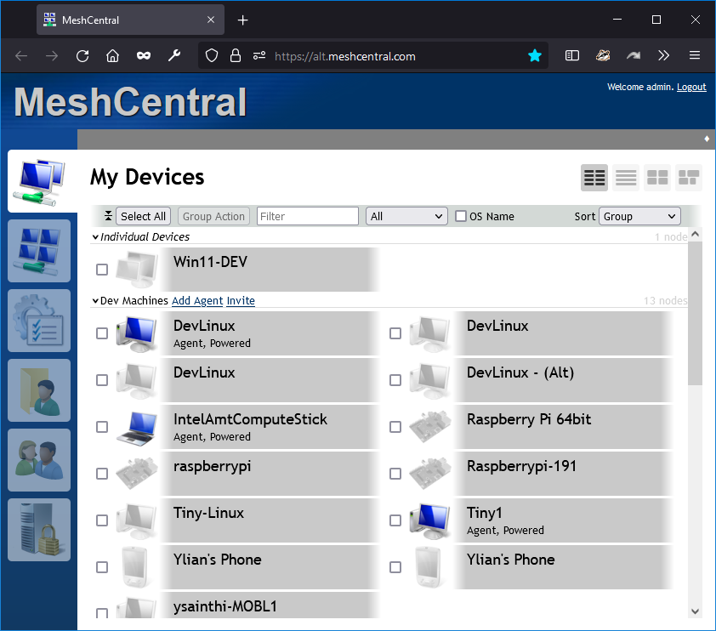
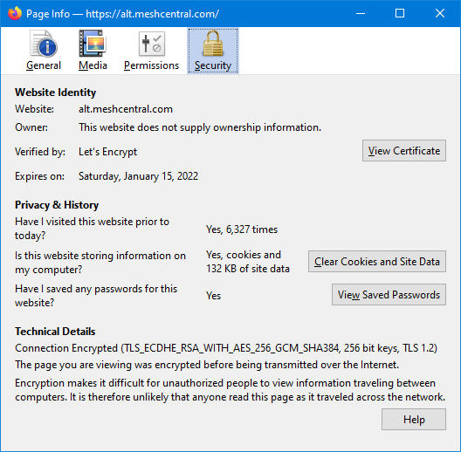

Slide 2




MeshCentral
Register
Prove domain control HTTP:80
ACME
Client
Get HTTPS certificate
MeshCentral switched from using GreenLock to ACME-Client for Let’s Encrypt support.

Slide 3
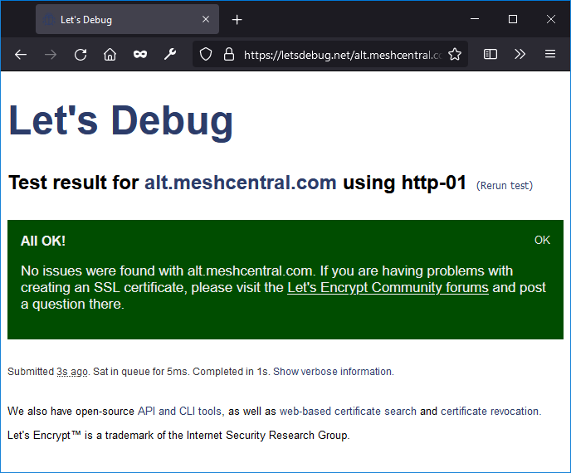
https://letsdebug.net

Slide 4
{
"settings": {
"cert": "myserver.com",
"port": 443,
"redirPort": 80
},
"domains": {
"": {
"title": "MyServer",
"title2": "Servername"
},
},
"letsencrypt": {
"email": "myemail@myserver.com",
"names": "myserver.com,customer1.myserver.com",
"production": false
}
}

Slide 5
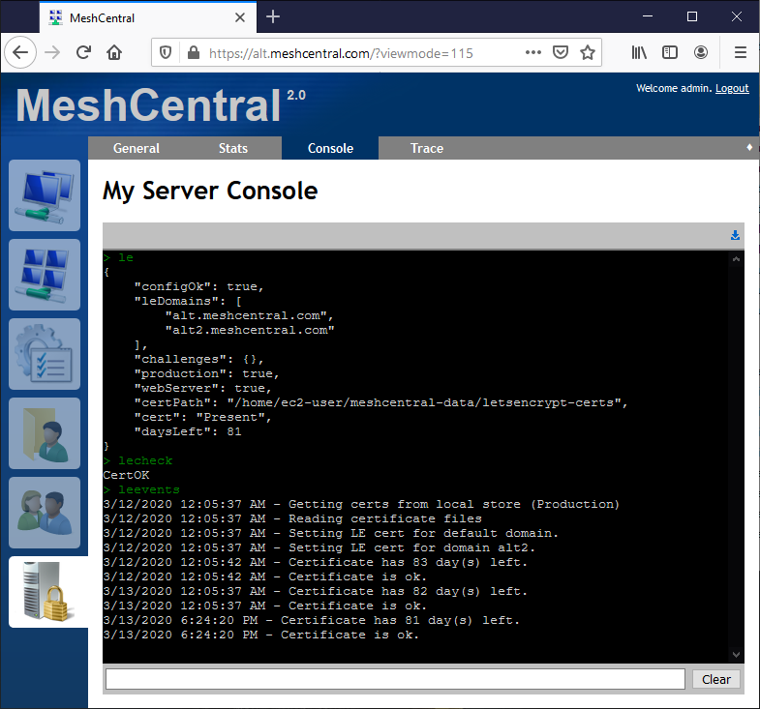
2
MeshCentral
NEW
MeshCentral administrators can now go in “My Server” / “Console” and type the following commands:
LE – Give you the status of the Let’s Encrypt library and certificate.
LECHECK – Immediately checks the certificate and attempts to renew if needed.
LEEVENTS – Returns the last 100 events related to Let’s Encrypt.
These commands make it easier to check the status of your certificate and debug any issues.

